Slide 1
Team XOcodes

Slide 2

About Software
The Software System is developed for an Oil Delivery System.
This is a real world requirement.
The system is currently deployed and running in the client environment with minor updates.

Slide 3

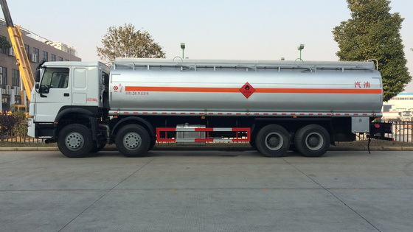
Main Functions of the system
Island wide coconut oil delivery with clients.
Transactions between clients are processed.
Bank transactions are recorded and proceed to deliver reports
Maintain their own coconut oil production line (mix products)
Maintain the stock in his own shop (shop transfer)
Salary payment for employees.
Daily attendance record maintain.
SMS alert system for working employees.

Slide 4
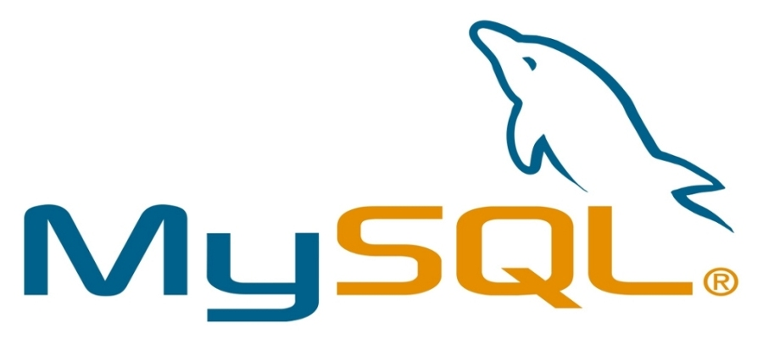

Software architecture
We used MVC architecture for the development of the software.
We used hibernate framework for manage MySql database
We used Both Java and C# language for the development.
We used Java Swing component for develop GUI

